Slide 1
Installation of ESP 5.2
Installation of ESP 5.2
Java SDK 1.4
FAST ESP 5.2
Service Pack 2

Slide 2
Re-Indexing Newslink 2.0 Content
Web91 – Dev ESP5.2
Web21 – Prod ESP5.2
Web178 – Prod ESP5.2
Web91
$FASTSEARCH/bin/. ./setupenv.sh
$ indexeradmin suspendindexing
$FASTSEARCH/bin/filetraverser -c ${COLLECTION[$ii]} -x:document:$INDEX_KEY –r $dir
/index/esp/data.org/data/data_fixml/Set_00001/*.gz, *.magic
Web21
Create stage from the Migration stage template, called MigrationNoChanges and set the ConfigFile parameter to Migration/MigrationConfig-NoChanges.xml.
$FASTSEARCH/bin/. ./setupenv.sh
$ indexeradmin suspendindexing
$ fixmlfeeder -i /index/esp52/temp2007 -c fullpagepdf -p fullpagepdf
$ indexeradmin resumeindexing

Slide 3
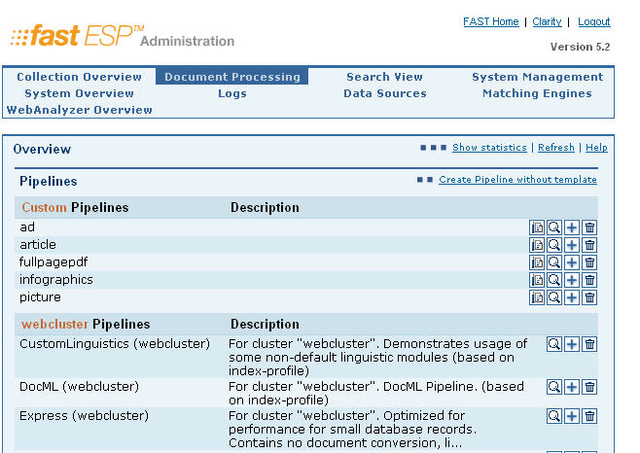
Re-Indexing Newslink 2.0 Content

Slide 4
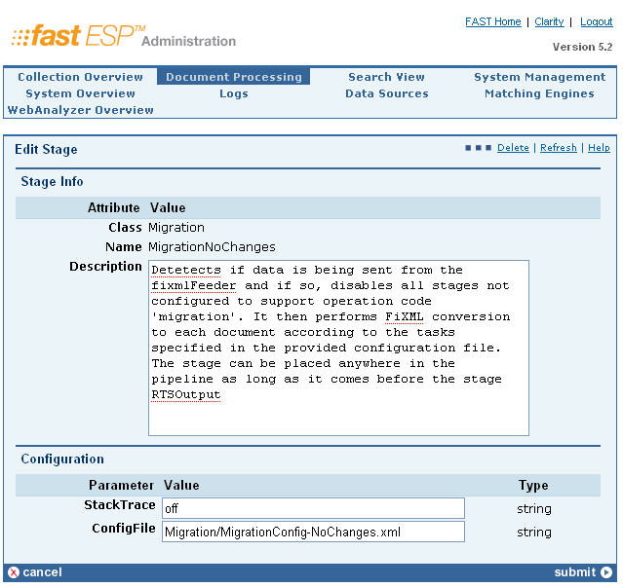
Re-Indexing Newslink 2.0 Content

Slide 5
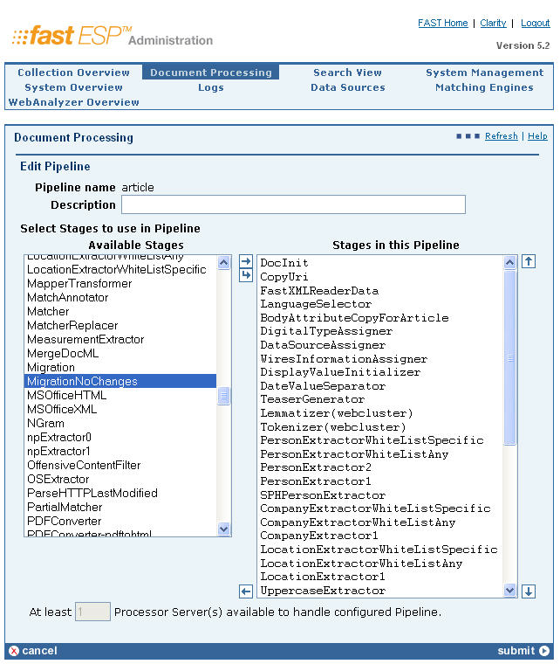
Re-Indexing Newslink 2.0 Content

Slide 6
Post Implementation Review
1. Project was implemented in 6 months.
2. The team made use of NetBeans version 6.x which is a very popular IDE, GlassFish webserver, Oracle Express Edition and Subversion tool.
3. We've also made a switch from Ext Javascript to JQuery to expedite the development.
4. Upgraded Newslink 2.0 to ESP 5.2 and re-indexed content from 1989 to Jan 2009.

Slide 7
Post Implementation Review
Value Add
Commitment
Synergy
Communication
- Listen carefully and take notes
- Take pic of details on drawing board
Checkpoint Meetings
Testing

